Slide 1
Learn Python 12
Vishal Yelisetti

Slide 2
Agenda
- Lambda Expressions
- Github Tutorial

Slide 3

Lambda Operations/Functions
A lambda function is a small anonymous function.
A lambda function can take any number of arguments, but can only have one expression.
$$\text{lambda} \text{arguments} \text{: }\text{expression}$$

Slide 4
Lambda Operations/Functions
Basic Lamba operator: https://cutt.ly/gghUDLF
Lambda Functions: https://cutt.ly/HghUHcV

Slide 5
Github Tutorial
Team 6328
Software Engineering

Slide 6

Overview
Install git and create a Github account
What is git?
How does git work?
What is GitHub?
Quick example using git and GitHub
Github icon

Slide 7

1
Install git and a create GitHub account

Slide 8
Install git
Linux (Debian)
Command: sudo apt-get install git
Linux (Fedora)
Command: sudo yum install git
Mac
http://git-scm.com/download/mac
Windows
http://git-scm.com/download/win

Slide 9
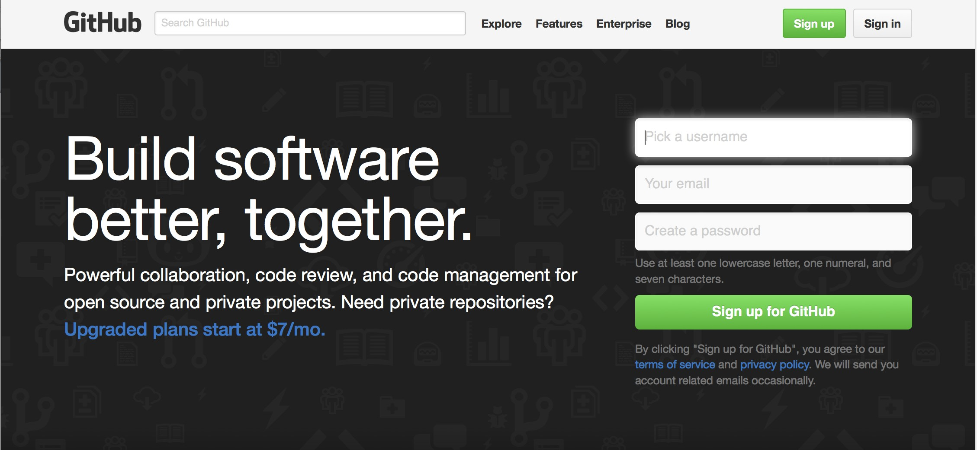
Create Github account
www.github.com
Free for public repositories

Slide 10
What is version control?
A system that keeps records of your changes
Allows for collaborative development
Allows you to know who made what changes and when
Allows you to revert any changes and go back to a previous state

Slide 11

2
What is git?

Slide 12
What is version control?
Distributed version control
Users keep entire code and history on their location machines
Users can make any changes without internet access
(Except pushing and pulling changes from a remote server)

Slide 13

What is git?
Started in 2005
Created by Linus Torvald to aid in Linux kernel development
Git icon

Slide 14



What is git?
Git isn’t the only version control system
But (we think) it’s the best

Slide 15

3
How does git work?

Slide 16
How does git work?
Can be complicated at first, but there are a few key concepts
Important git terminology in following slides are blue

Slide 17
Key Concepts: Snapshots
The way git keeps track of your code history
Essentially records what all your files look like at a given point in time
You decide when to take a snapshot, and of what files
Have the ability to go back to visit any snapshot
Your snapshots from later on will stay around, too

Slide 18
Key Concepts: Commit
The act of creating a snapshot
Can be a noun or verb
“I commited code”
“I just made a new commit”
Essentially, a project is made up of a bunch of commits

Slide 19
Key Concepts: Commit
Commits contain three pieces of information:
Information about how the files changed from previously
A reference to the commit that came before it
Called the “parent commit”
A hash code name
Will look something like:
fb2d2ec5069fc6776c80b3ad6b7cbde3cade4e

Slide 20
Key Concepts: Repositories
Often shortened to ‘repo’
A collection of all the files and the history of those files
Consists of all your commits
Place where all your hard work is stored

Slide 21
Key Concepts: Repositories
Can live on a local machine or on a remote server (GitHub!)
The act of copying a repository from a remote server is called cloning
Cloning from a remote server allows teams to work together

Slide 22
Key Concepts: Repositories
The process of downloading commits that don’t exist on your machine from a remote repository is called pulling changes
The process of adding your local changes to the remote repository is called pushing changes

Slide 23
Key Concepts: Branches
All commits in git live on some branch
But there can be many, many branches
The main branch in a project is called the master branch

Slide 24
So, what does a typical project look like?
A bunch of commits linked together that live on some branch, contained in a repository
Following images taken and modified from:
http://marklodato.github.io/visual-git- guide/index-en.html
Also a good tutorial!

Slide 25
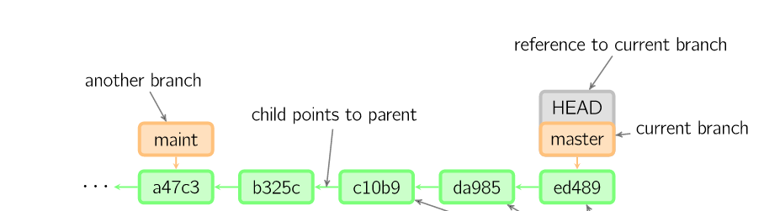

So, what does a typical project look like?
Time going forward

Slide 26
So, what is HEAD?
Time going forward

Slide 27
So, what is HEAD?
A reference to the most recent commit
Time going forward

Slide 28
So, what is HEAD?
A reference to the most recent commit
(in most cases – not always true!)
Time going forward

Slide 29
So, what is MASTER?
The main branch in your project
Doesn’t have to be called master, but almost always is!
Time going forward

Slide 30
Key Concepts: Branching oﬀ of the master branch
The start of a branch points to a specific commit
When you want to make any changes to your project you make a new branch based on a commit

Slide 31
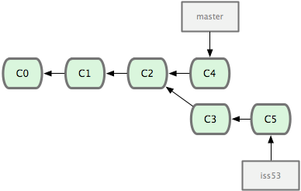
Key Concepts: Branching oﬀ of the master branch
Images from: http://codingdomain.com/ git/merging/
Time going forward

Slide 32
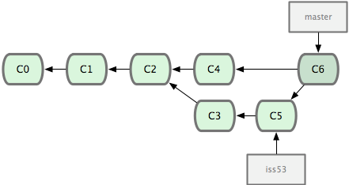

Key Concepts: Merging
Once you’re done with your feature, you merge it back into master
Time going forward

Slide 33
Key Concepts: How do you make a commit anyway?
There are a lot of ‘states’ and ‘places’ a file can be
Local on your computer: the ‘working directory’
When a file is ready to be put in a commit you add it onto the ‘index’ or ‘staging’
Staging is the new preferred term – but you can see both ‘index’ and ‘staging’ being used

Slide 34
Key Concepts: How do you make a commit anyway?
The process:
Make some changes to a file
Use the ‘git add’ command to put the file onto the staging environment
Use the ‘git commit’ command to create a new commit’

Slide 35
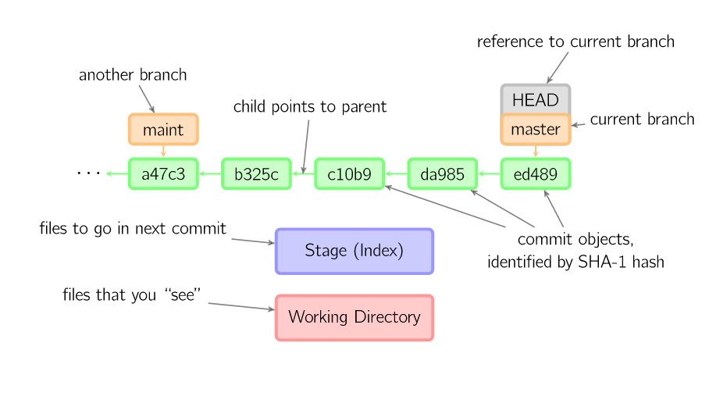

Key Concepts: How do you make a commit anyway?
Time going forward

Slide 36
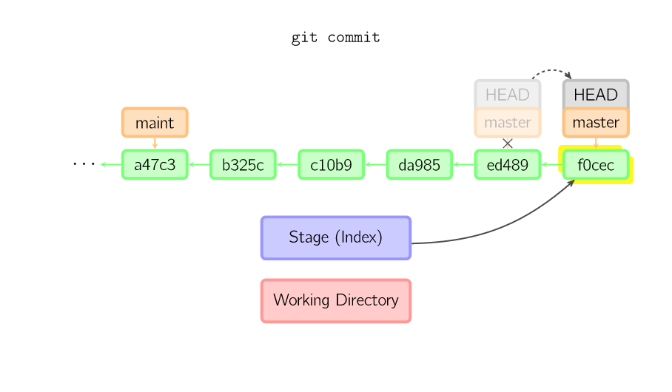
Key Concepts: How do you make a commit anyway?
Time going forward

Slide 37


Additional Resources

Slide 38
Additional Resources
Oﬃcial git site and tutorial:
https://git-scm.com/
GitHub guides:
https://guides.github.com/
Command cheatsheet:
https://training.github.com/kit/ downloads/github-git-cheat-sheet.pdf
Interactive git tutorial:
https://try.github.io/levels/1/challenges/1
Visual/interactive cheatsheet:
http://ndpsoftware.com/git-cheatsheet.html

